Slide 1
Visual Analyses of Meta-Kaggle Data to Uncover Trends in the Data Science Landscape
ENGR-E583: Client Project
Yeon-Soo Chung (Team Leader)
Kabir Chaturvedi
Bhoomika Pathapati
Monisha Patro
Ishika Thakur

Slide 2
Outline
Introduction
Background
Analysis of Competition Submissions
Temporal Trends in Submissions
Popularity of Programming Languages
Deep Learning Frameworks & R Packages Usage
Data Science Techniques
Conclusion and Future Work

Slide 3
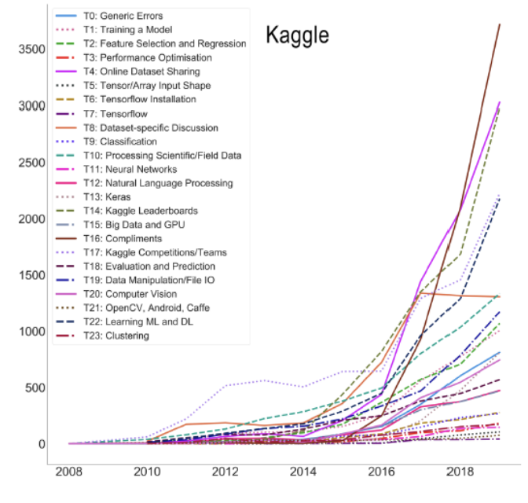
Introduction
Purpose:
Explore trends in Kaggle as a reflection of broader data science trends.
Tech Stack:
Python, Matplotlib, Seaborn.
Data Source:
Meta-Kaggle dataset with comprehensive Kaggle activity data.

Slide 4
Background
Kaggle's Role in Data Science:
Platform Overview: Kaggle is a pivotal platform for data scientists to share knowledge, collaborate on projects, and compete, reflecting broader data science trends.
Meta-Kaggle Dataset:
Data Richness: The dataset contains detailed records from Kaggle, including over 5.6 million competitions and nearly 14 million datasets across 32 tables.
Key Data Used: Focus on competitions, submissions, and user activities to analyze trends and patterns effectively.
Goal:
To uncover trends within the Kaggle community and understand shifts in the data science field.

Slide 5
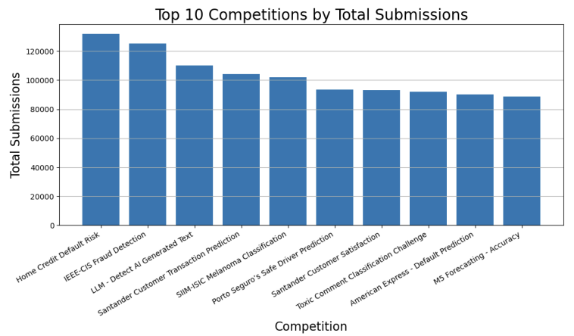
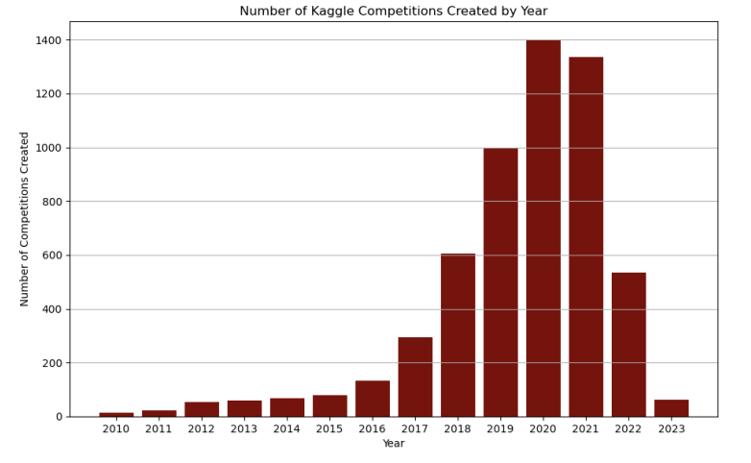
Analysis of Competition Submissions
Finance Focus: Competitions like "Home Credit Default Risk" and "Santander Customer Satisfaction" indicate that financial topics are popular on Kaggle, often attracting many submissions due to substantial rewards.
High Engagement: The consistent high number of submissions in top competitions reflects strong engagement within the Kaggle community, especially when monetary incentives are involved, highlighting where Kaggle users focus their efforts.
The decline in the number of Kaggle competitions after 2020 suggests that there might be a shift in platform focus or changes in user engagement, even though the total number of submissions remains high.

Slide 6
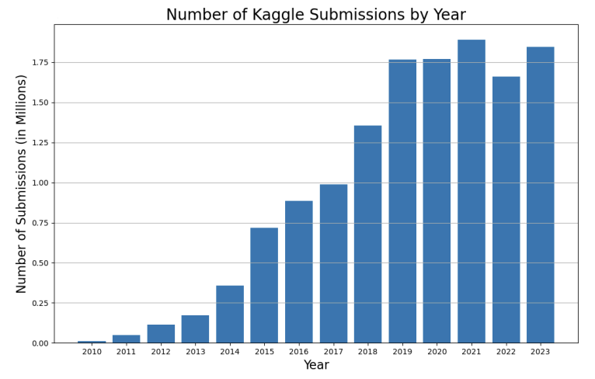
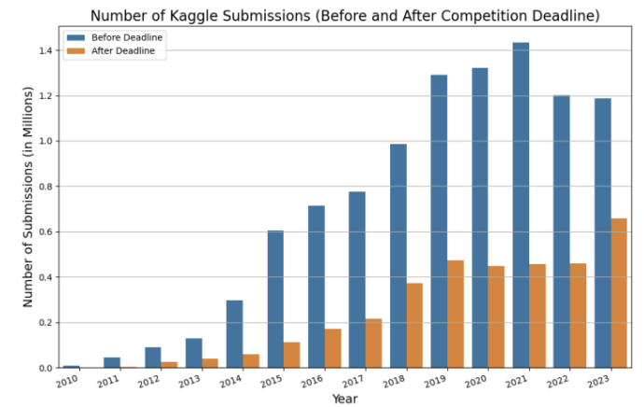
Temporal trends in Submissions
1
Steady Growth in Submissions: The top graph shows a clear upward trend in Kaggle submissions from 2010 to 2023, indicating a growing interest in data science competitions over the years, with a peak around 2019-2021.
Majority Pre-Deadline: The second graph shows most Kaggle competition submissions happen before deadlines, highlighting strong engagement and adherence to timelines despite a decrease in new competitions.

Slide 7
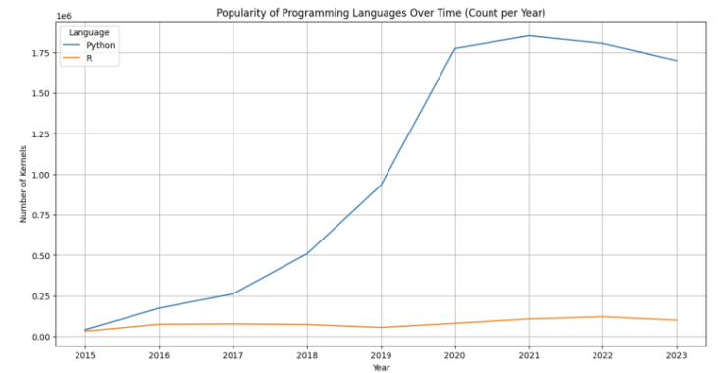
Popularity of Programming Languages
Python dominates due to its ML capabilities; R remains steady due to its statistical analysis strength.
The chart illustrates Python's prevalence as the preferred language for machine learning on Kaggle, while R maintains a niche for statistical analysis, informing educational focus areas for new data scientists.

Slide 8
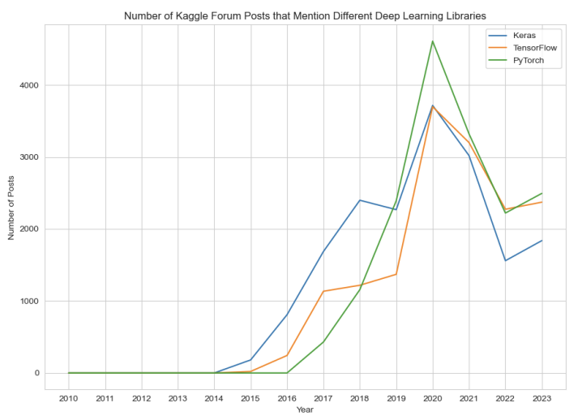
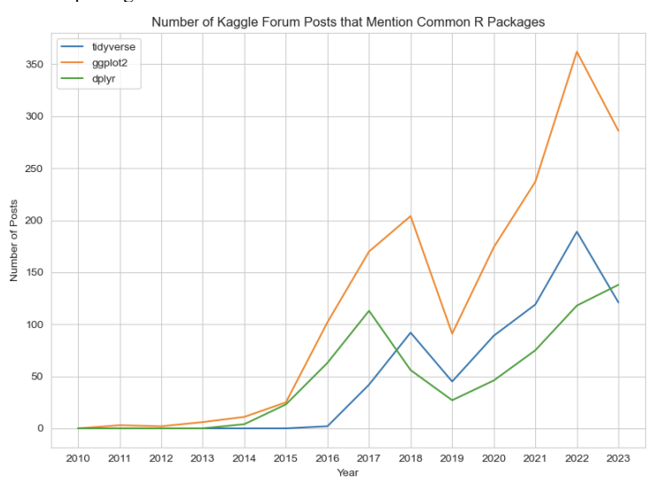
Deep Learning Frameworks and R Packages Usage
Framework Usage Analysis: Keras, TensorFlow, PyTorch usage trends in forum mentions.
Current Status: PyTorch and TensorFlow are currently the leading frameworks in discussions.
Popular Packages: Trends in mentions of tidyverse, ggplot2, and dplyr in forums.
Result: ggplot2 leads due to its strong visualization capabilities.

Slide 9
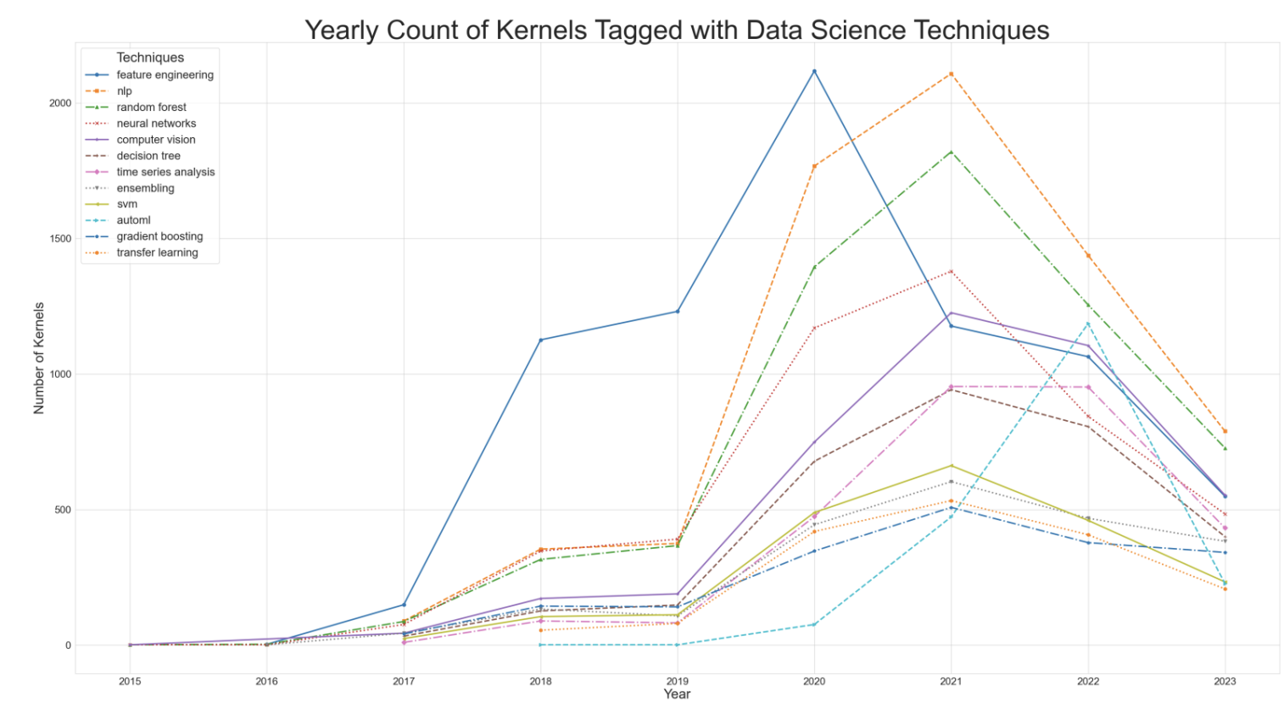
Data Science Techniques
Technique Popularity: Annual count of kernels tagged with various data science techniques.
Highlights: Sharp increase in interest during the COVID-19 pandemic, particularly in NLP, computer vision, and feature engineering.
Technique Diversification: A variety of techniques being explored and shared through kernels indicate a diverse interest and expertise within the Kaggle community.

Slide 10

Conclusion and Future Work
Summary of Findings:
High correlation between the number of submissions and ongoing interest in data science.
Trends suggest fad-like behaviors in techniques such as AutoML.
Future Work: Monitoring evolving trends in data science, particularly the uptake of new techniques and tools.

Slide 11
THANK YOU!

